Slide 1
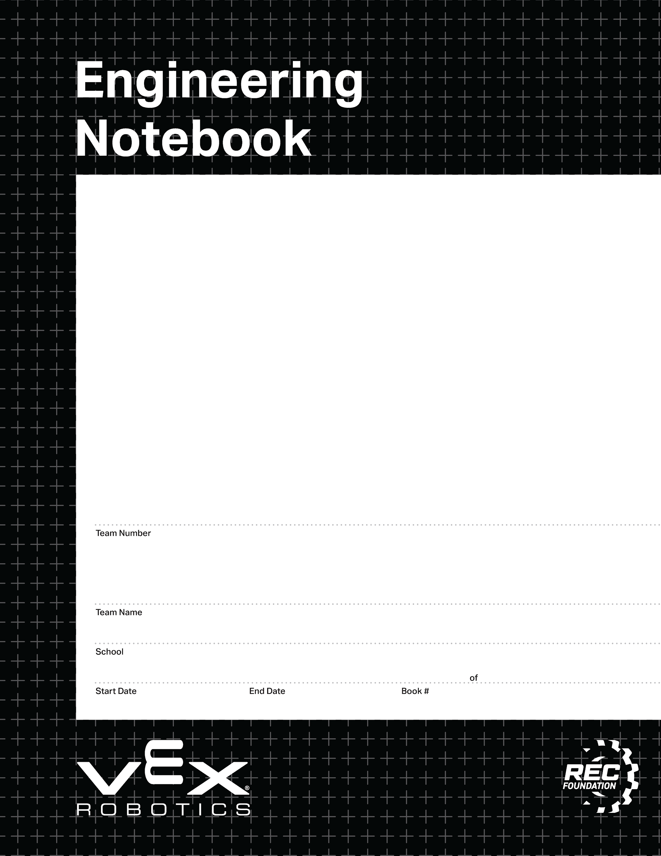

37528C
TyDoMaL
Colorado Early Colleges Windsor
13/08/2025
06/15/2026
1
1
V3.0 Date 6.10.24

Slide 2
Team Rules:
The following rules were picked by our team, to be used for the duration of this project. These rules are meant to help us resolve conflicts, work effectively, and prevent issues from happening during our project. These can be changed if agreed upon by the whole team.
If we get mad we will express ourselves to find what went wrong and how we can fix it
If you are doing a job such as building designing coding or mapping the controller you have to update note book not tomorrow or latter but the day of.
Research before you debate
No copyrighting or stealing content ,cite any info for the robot, and ask teams opinion
Try to at least get one thing done no playing around, communicate distress, and let team know before leaving
Team members present:
Dontae Brown
Marco Banuelos
Tyler Painter
Alice Schutt
/0813/2025

Slide 3
1 | Team Rules | 8/1/2025
2 | Section A: Blank Documents | 8/1/2025
3 | Blank Sprint Plan | 8/1/2025
4 | Blank Scrum Meeting worksheet | 8/1/2025
5 | Blank Sprint Retrospective worksheet | 8/1/2025
6 | Blank Sprint Review worksheet | 8/1/2025
7 | Blank Research worksheet | 8/1/2025
8 | EXAMPLE research worksheet. | 8/1/2025
9 | EXAMPLE design worksheet | 8/1/2025
10 | Blank Design worksheet (1/2 scale) | 8/1/2025
11 | Blank Design worksheet (full scale) | 8/1/2025
12 | Blank Design worksheet (1/2 scale) | 8/1/2025
13 | Blank Design worksheet (1/3 scale) | 8/1/2025
15 | Blank Brain diagram worksheet | 8/1/2025
16 | Blank Controller setup worksheet | 8/1/2025
17 | Gear Ratio worksheet | 8/1/2025
18 | Section B: Filled in worksheets | 8/1/2025
25 | Sprint Plan 1 | 8/18/25
26 | Research Page | 8/19/25
27 | Plan and design | 8/19-21/25
28 | Scrum Meeting 1 | 8/25/25
29 | Brain Port diagram | 8/25/2025
30 | Research Page 1 | 8/26/2025
31 | Autonomous Skills Visual Plan | 8/27-28/2025
32 | Sprint Retrospective | 8/29/2025
33 | Sprint Review | 8/29/2025
34 | Sprint 2 Plan | 9/4/2025
35 | Scrum Meeting 2 | 9/3-5/2025
36 | Research Page for Outtake | 9/5/2025
37 | Design Page for top of robot | 9/8/2025
38 | Scrum Meeting 3 | 9/8-12/2025
39 | Design Page for intake | 9/9/2025
40 | Scrum meeting 09/15/2025 | 9/15-20/2025
41 | Scrum meeting 09/22/2025 | 9/22-27/2025
42 | Sprint Retrospective | 9/23/2025
43 | Sprint Review | 9/23/2025
44 | Sprint Plan 3 | 9/23/2025
45 | Test 1 | 9/23/2025
46 | Scrum Meeting 4 | 9/29-3/2025
47 | Scrum Meeting 5

Slide 4
48 | Updated Plan and design | 8/19-21/2025
49 | Scrum Meetings | 10/20-24/2025
50 | Sprint Retrospective | 10/31/2025
51 | Sprint Review | 10/31/2025
52 | Competition 1 Reflection | 11/3/2025
53 | Scrum meeting | 11/4/2025
54 | Sprint Plan 4 | 11/4/2025
55 | Scrum Meetings 11/10-14/2025 | 11/10-14/2025
56 | Scrum Meetings 11/17-21/20205 | 11/17-21/2025
57 | Testing worksheet | 11/20/2025
58 | Scrum Meetings 12/1-5/2025 | 12/1-5/2025
59 | Controller worksheet | 12/4/2025
60 | Sprint Retrospective 4 | 12/5/2025
61 | Sprint Review | 12/5/2025
62 | Scrum Meetings | 12/8-12/2025
63 | Scrum Meetings | 1/7-9/26
64

Slide 6
Section A
This section contains the blank documents for your use.
Make sure to duplicate these (or copy/paste) BEFORE you use/move them.

Slide 7
Sprint Plan (Sprint backlog and burndown)
Sprint #:
Team:
Team Members Present:
Product Backlog (at the start of this sprint, what is your product backlog):
Sprint Goal (write in full sentences what concise goal you have for the sprint):
Sprint Backlog / Burndown (Break product backlog items into sprint backlog items)
Remember to INDENT sprint backlog items:
Task Date and name of who worked on:
Page:

Slide 8
Scrum meeting. Week of: MM/DD/YYYY
SCRUM Meetings
Week of 00/00/2025
Monday: What has each team member done since the last meeting? What will each team member do today? What problems are holding the team back?
Tuesday: What has each team member done since the last meeting? What will each team member do today? What problems are holding the team back?
Wednesday: What has each team member done since the last meeting? What will each team member do today? What problems are holding the team back?
Thursday: What has each team member done since the last meeting? What will each team member do today? What problems are holding the team back?
Friday: What has each team member done since the last meeting? What will each team member do today? What problems are holding the team back?

Slide 9
Sprint Retrospective
Sprint #:
Team:
Team Members Present:
During the Sprint Retrospective you will talk with your team and discuss the last sprint. You will need to reflect on how well your team is working together, be respectful but honest, and everyone should be allowed to express themselves. Then, answer the following questions:
What is working for our team, that we should CONTINUE doing (use complete sentences):
2. What is not working for our team, that we should STOP doing (use complete sentences):
3. What do we want to try doing as a team, that we should START doing (use complete sentences):
For Each thing we want to stop doing, we should have a thing to start that solves the issue!
Date:
Page:

Slide 10
Sprint Review
Sprint #:
Team:
Team Members Present:
Using complete sentences, give a summary of what your team accomplished this sprint. Also, identify which product backlog items you fully completed:
2. Using complete sentences, tell me what your sprint goal was, did you meet that goal this sprint, and why you did or did not meet that goal:
3. What sprint backlog items do you need to move back to your product backlog? Put them in order of priority, highest priority should be at the top of the list.
4. Demonstrate the product that you produced this sprint.
Page:

Slide 11
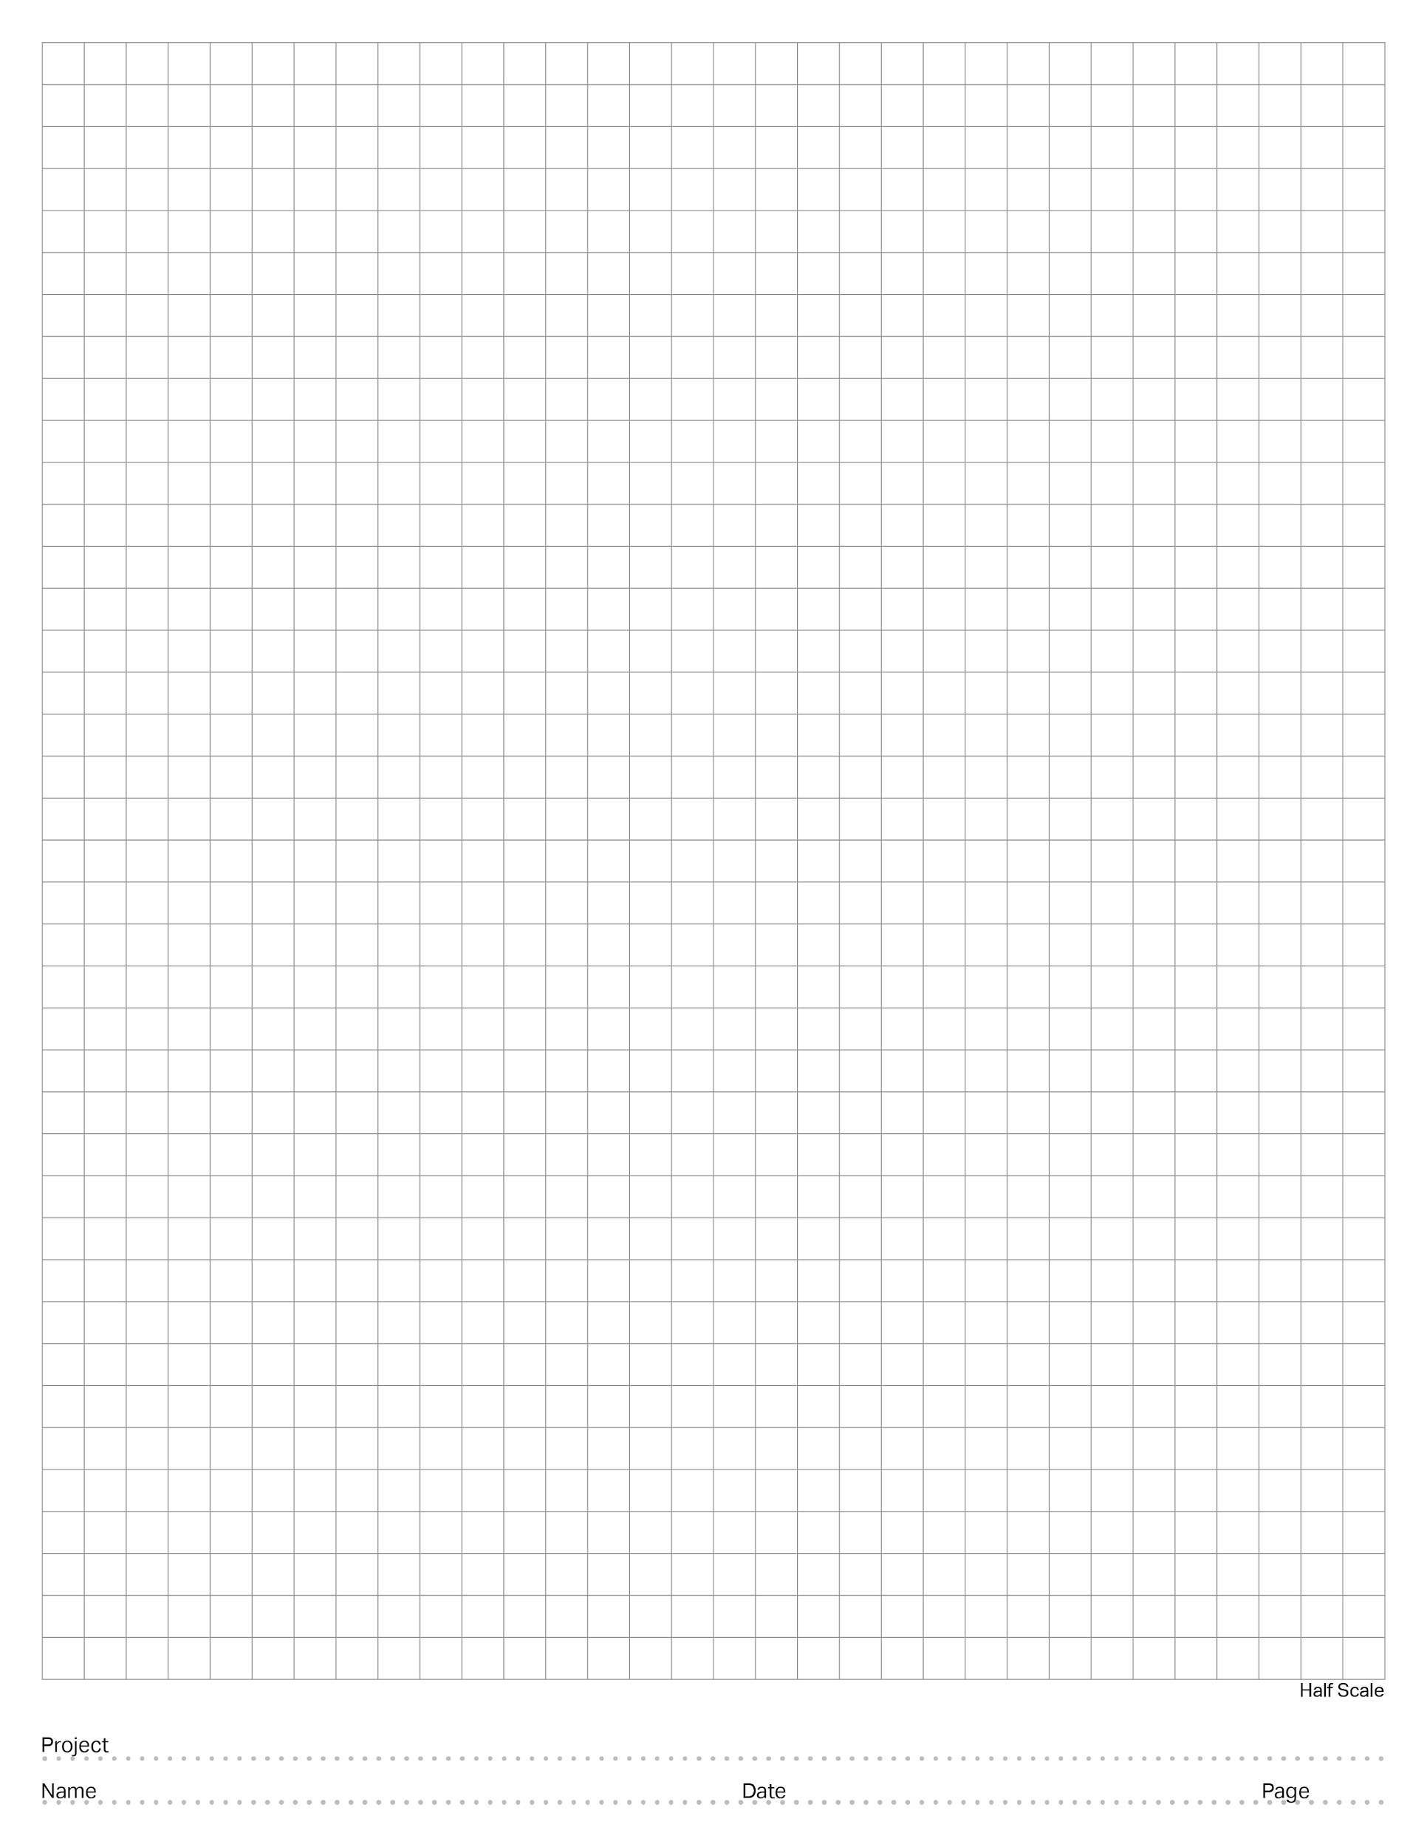
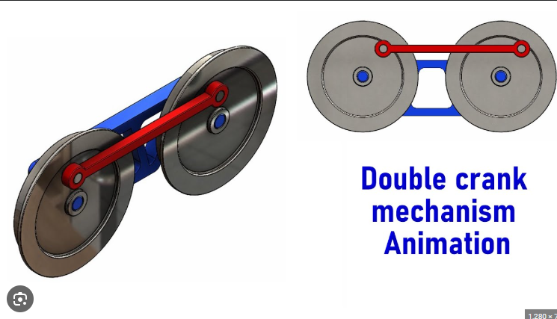
Nothing but Net
EXAMPLE - Research Page:
Identify the problem:
Clearly state an individual problem that you need to try to solve, or task that you are trying to make your robot accomplish. (i.e. do you need to lift something, grab something, push something, turn better, etc.)
I need to make a mechanism that moves a flat surface laterally, this will lift the ball up and back to my launching mechanism.
2. Find real-world examples:
Paste in pictures, video links, or screenshots of real-world examples that look like they could do the thing you are trying to do.
3. Brainstorm:
How could this example be scaled down or changed to solve your problem? What could you do to make it work?
If I use gears the same way that this train wheel double-crank mechanism works, I can easily move the ball how I need to.
Mr. Lyon
4/15/2025
5

Slide 12
Research Page:
Identify the problem:
Clearly state an individual problem that you need to try to solve, or task that you are trying to make your robot accomplish. (i.e. do you need to lift something, grab something, push something, turn better, etc.)
2. Find real-world examples:
Paste in pictures, video links, or screenshots of real-world examples that look like they could do the thing you are trying to do.
3. Brainstorm:
How could this example be scaled down or changed to solve your problem? What could you do to make it work?

Slide 13
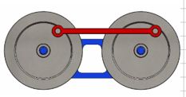

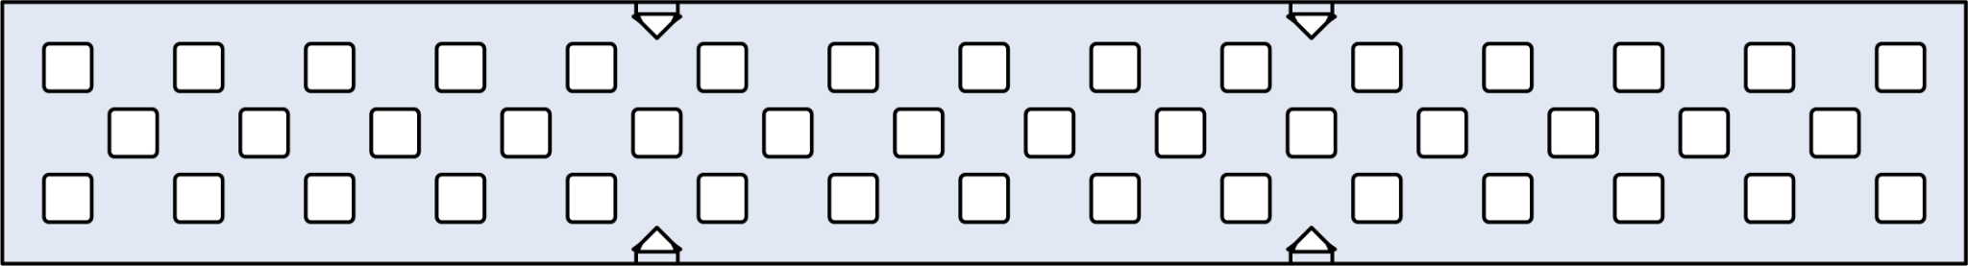


Nothing but Net Bot
EXAMPLE - Plan and Design Page:
-Drag, drop, rotate, and position vex V5 parts from the PowerPoint “V5 Parts Library” onto this slide to plan out how your robot or robot mechanism will fit together.
-Use the ‘crop’ tool to cut pieces down, DO NOT just drag them bigger/smaller. This will mess up the scale of your design, and the parts will not fit together on your robot that way.
-This design should come AFTER a filled-out research page.
-This design isn’t a copy of what we already built, it’s a plan for what we want to build.
Double crank mechanism to lift balls to shooting area~!
-use aluminum so this is light and strong
-Cut the short edges off so this is thinner but retains strength
-standoffs to span space for rubber bands to lift ball
Slip inserts so the gears spin smoothly
Mr. Lyon
4/16/2025
6

Slide 14
Plan and Design Page:
-Drag, drop, rotate, and position vex V5 parts from the PowerPoint “V5 Parts Library” onto this slide to plan out how your robot or robot mechanism will fit together.
-Use the ‘crop’ tool to cut pieces down, DO NOT just drag them bigger/smaller. This will mess up the scale of your design, and the parts will not fit together on your robot that way.
-This design should come AFTER a filled-out research page.
-This design isn’t a copy of what we already built, it’s a plan for what we want to build.

Slide 15
Plan and Design Page:
-Drag, drop, rotate, and position vex V5 parts from the PowerPoint “V5 Parts Library” onto this slide to plan out how your robot or robot mechanism will fit together.
-Use the ‘crop’ tool to cut pieces down, DO NOT just drag them bigger/smaller. This will mess up the scale of your design, and the parts will not fit together on your robot that way.
-This design should come AFTER a filled-out research page.
-This design isn’t a copy of what we already built, it’s a plan for what we want to build.

Slide 16
Plan and Design Page:
-Drag, drop, rotate, and position vex V5 parts from the PowerPoint “V5 Parts Library” onto this slide to plan out how your robot or robot mechanism will fit together.
-Use the ‘crop’ tool to cut pieces down, DO NOT just drag them bigger/smaller. This will mess up the scale of your design, and the parts will not fit together on your robot that way.
-This design should come AFTER a filled-out research page.
-This design isn’t a copy of what we already built, it’s a plan for what we want to build.

Slide 17
Plan and Design Page:
-Drag, drop, rotate, and position vex V5 parts from the PowerPoint “V5 Parts Library” onto this slide to plan out how your robot or robot mechanism will fit together.
-Use the ‘crop’ tool to cut pieces down, DO NOT just drag them bigger/smaller. This will mess up the scale of your design, and the parts will not fit together on your robot that way.
-This design should come AFTER a filled-out research page.
-This design isn’t a copy of what we already built, it’s a plan for what we want to build.

Slide 18
Testing Worksheet
Mechanism: Builder:
Tester:
Use this worksheet to test the mechanism that you researched, planned, and then built.
Does the mechanism perform the function as intended?
Does the mechanism fit within the games rule requirements?
Durability testing, does the mechanism hold up to the following?
Impact - (bump from various directions)
Torsion - (twisting force, try and spin it.)
Load - (does it hold appropriate weight)
Torque - (if is motorized, can it supply enough power?)
Bending - (apply force to one side, then another)
Handling - (Does the robot still drive as expected with the mechanism installed?)
Cycle - (how many times can it do its function repeatedly)
Does the mechanism perform under game conditions?
Test Feedback:
What did you learn from your testing? Think about usable quantitative data (measurements) and qualitative data (observations and opinions). Do we need a full redesign, or can we change something small to gain the functionality that we wanted? If redesign is needed, go back to the research/brainstorm step, and do that worksheet again!
Date:
Page:

Slide 19
PORT
PORT
PORT
PORT
PORT
PORT
PORT
PORT
PORT
PORT
PORT
PORT
PORT
PORT
PORT
PORT
PORT
PORT
PORT
PORT
PORT
PORT
PORT
PORT
PORT
PORT
PORT
PORT
PORT

Slide 20
BUMPER
BUMPER
BUMPER
BUMPER
STICK
STICK
STICK
STICK
BUTTON
BUTTON
BUTTON
BUTTON
BUTTON
BUTTON
BUTTON
BUTTON

Slide 21
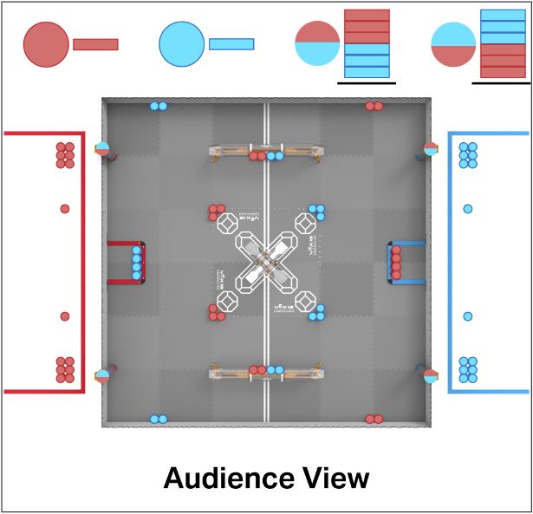
“High Stakes” Starting Field with Frozen Game Objects

Slide 22
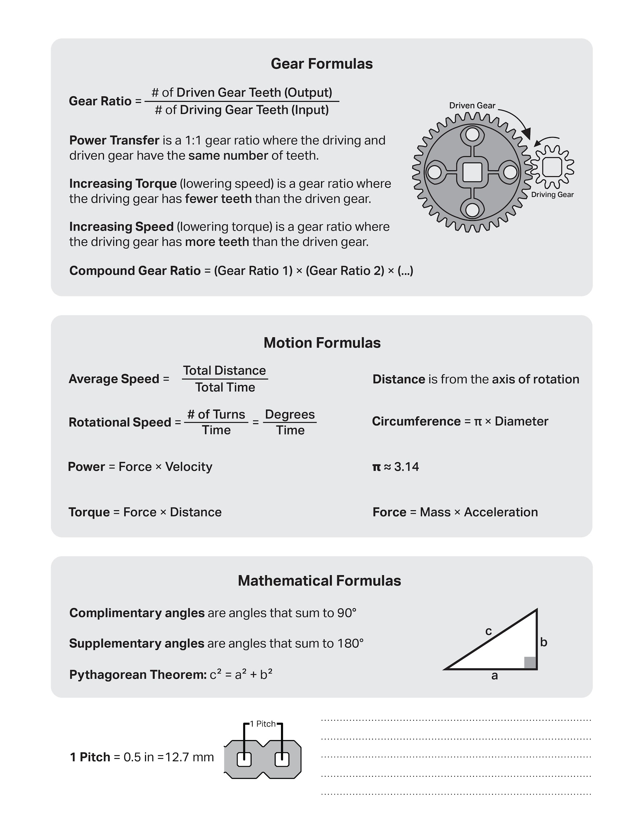

Slide 23
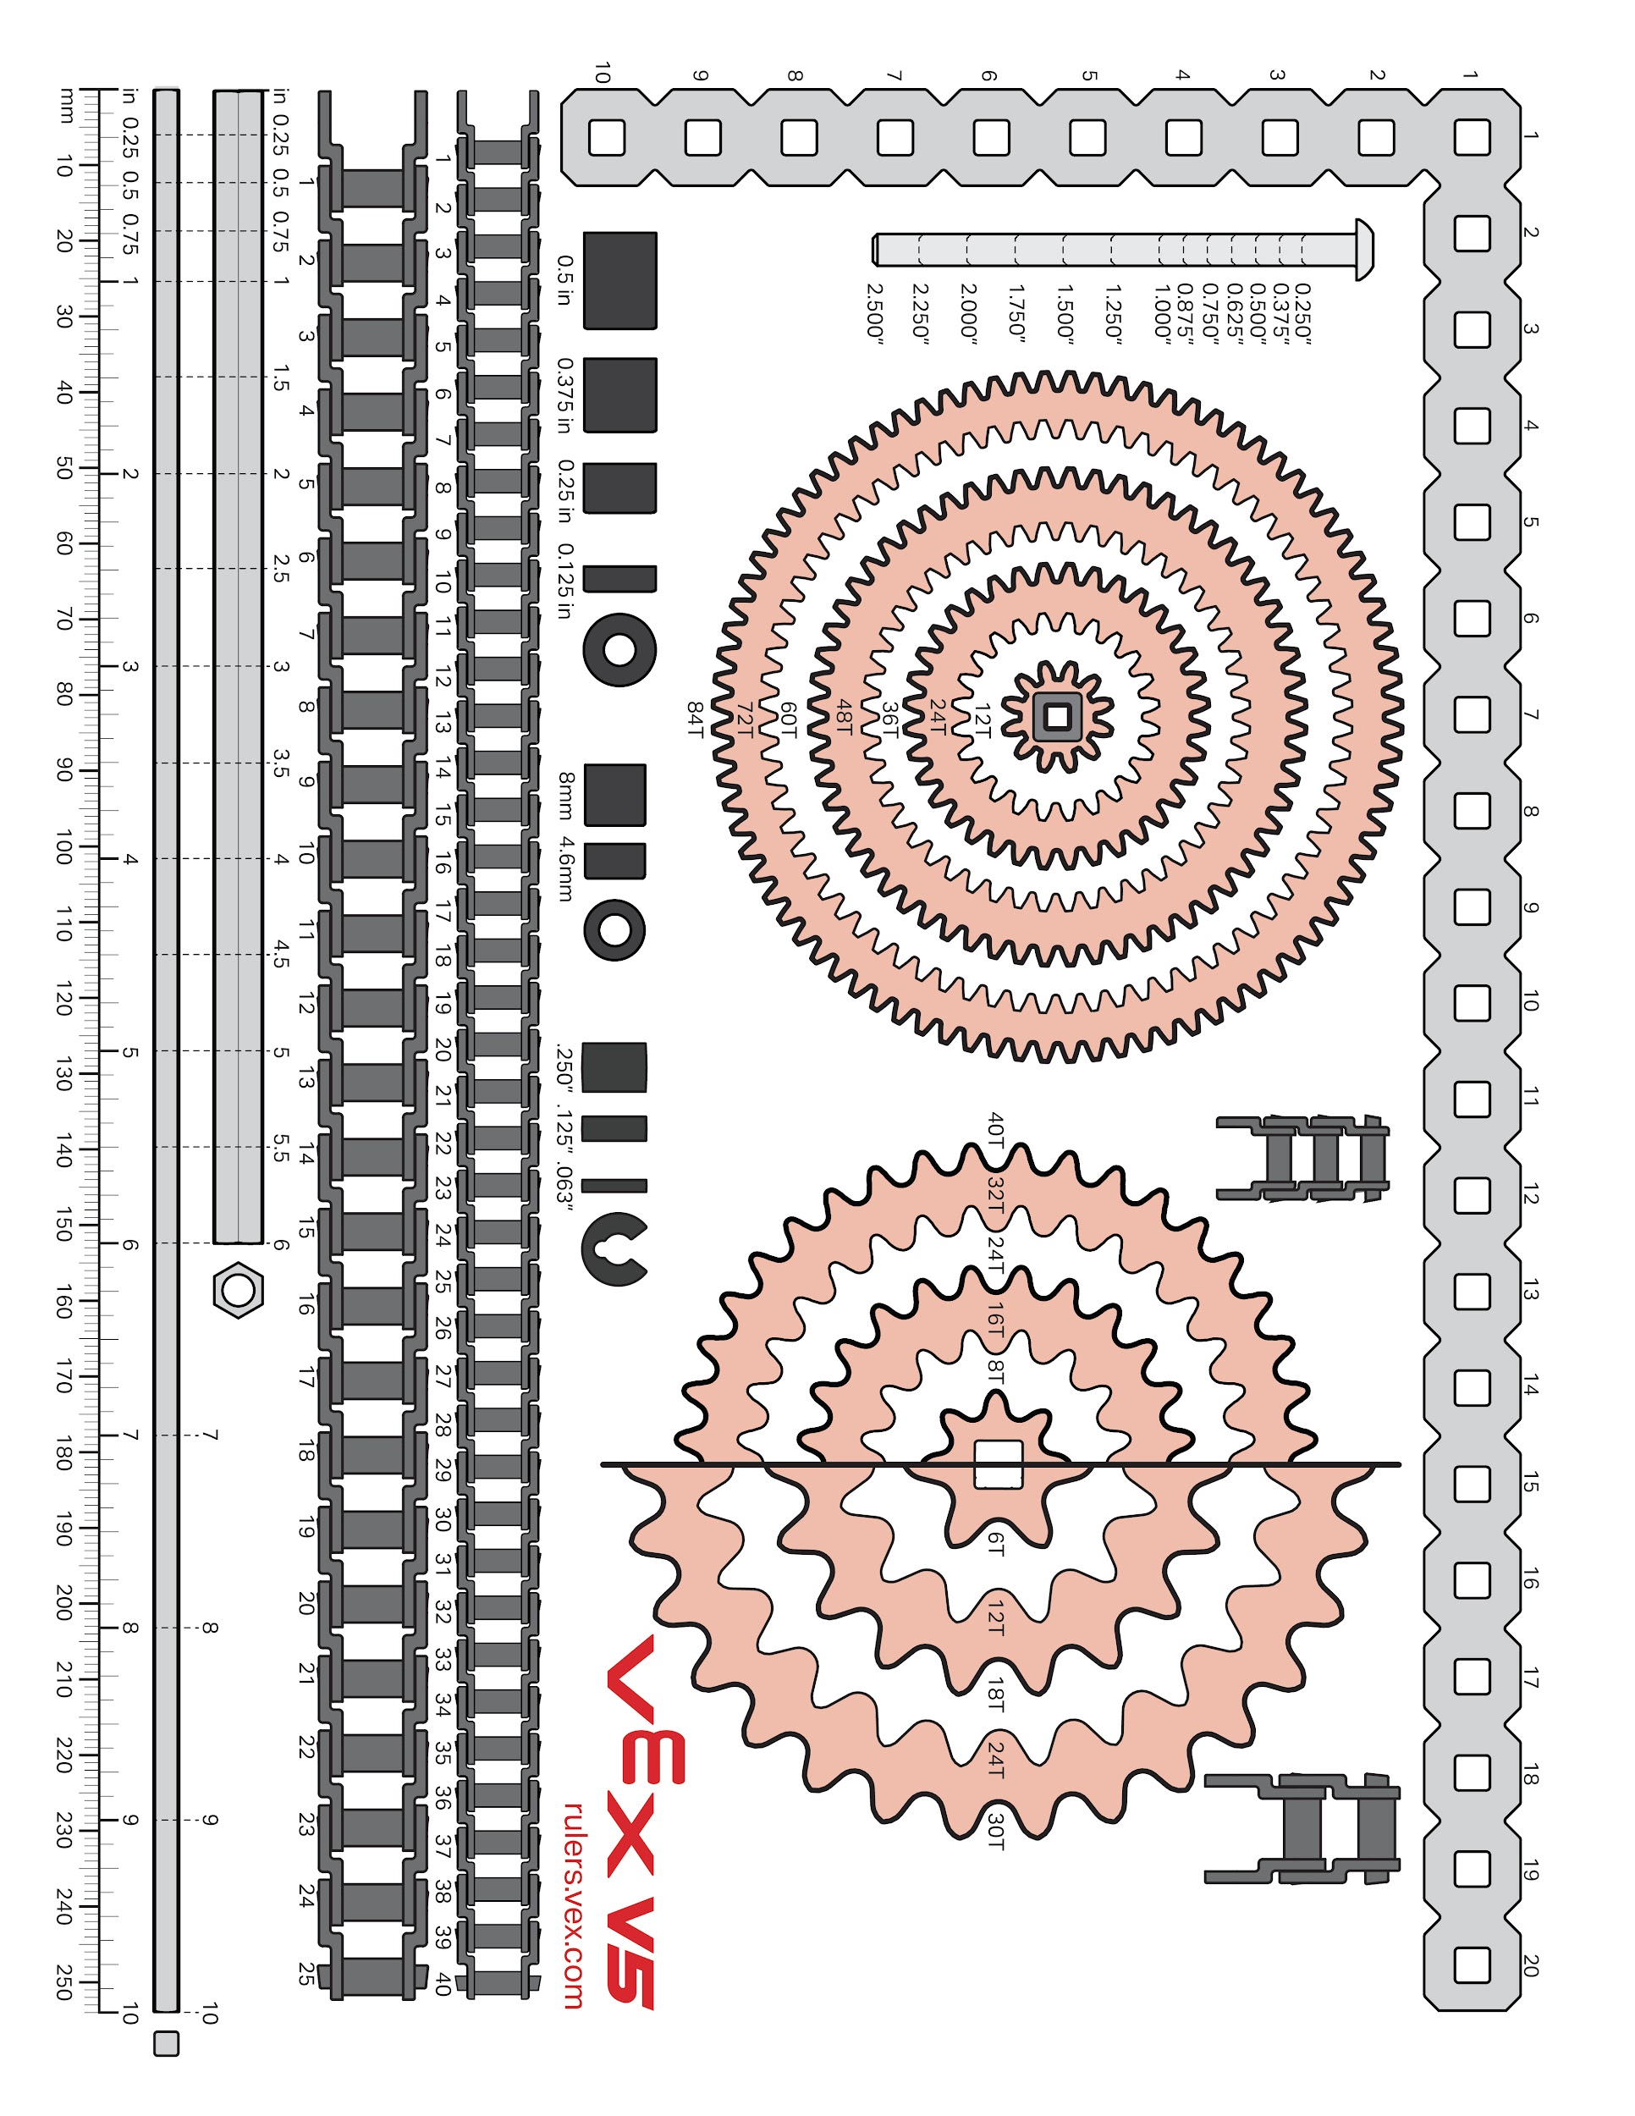

Slide 24
Section B
This section contains the filled-in documents for your notebook.
These should be in chronological order, with older documents at the beginning, and new documents at the end.

Slide 25
Sprint Plan (Sprint backlog and burndown)
Sprint #:
Team:
1
Team Members Present:
TyDoMaL
Donta Brown, Tyler Painter, Marco Banuells
Product Backlog (at the start of this sprint, what is your product backlog):
Research the drivetrain
Create the Drivetrain
Create Mechanism
Coding
Test and evaluate
Sprint Goal (write in full sentences what concise goal you have for the sprint):
Our sprint goal is to make the base of a robot, the drivetrain, and to test and evaluate it.
Code and build the controller code.
Sprint Backlog / Burndown (Break product backlog items into sprint backlog items)
Remember to INDENT sprint backlog items:
Task Date and name of who worked on:
Frame
> Research | MB, DB, TP, and ARS
> Build | MB, DB
wheels
> Research | MB, DB, TP and ARS
> Attach | DB, TP
> Attach motor | MB, DB
Drivetrain
> Attach brain | MB
> Attach sensors | MB AS
> attach motors | MB DB
> Attach wires | MB AS
> Test and evaluate
Coding
Code controller
1
Page:

Slide 26
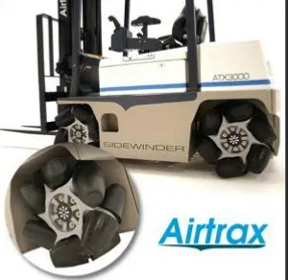
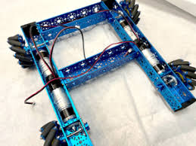
Research page
Research Page:
Identify the problem:
Clearly state an individual problem that you need to try to solve, or task that you are trying to make your robot accomplish. (i.e. do you need to lift something, grab something, push something, turn better, etc.)
we need to build a robot as compact and small as possible to be a vessel for the other mechanisms.
2. Find real-world examples:
Paste in pictures, video links, or screenshots of real-world examples that look like they could do the thing you are trying to do.
https://youtu.be/noqBUEgyQ8A?si=8_zEx_J2DsPjzXpZ
3. Brainstorm:
How could this example be scaled down or changed to solve your problem? What could you do to make it work?
We can make it smaller (12x12.5). We want our robot to have strafe moveent to score on the tube goals, this type of drive train would be perfect.
Tyler
8/23/2025
2

Slide 27







Frame and wheels as well as brain and battery
Plan and Design Page:
-Drag, drop, rotate, and position vex V5 parts from the PowerPoint “V5 Parts Library” onto this slide to plan out how your robot or robot mechanism will fit together.
-Use the ‘crop’ tool to cut pieces down, DO NOT just drag them bigger/smaller. This will mess up the scale of your design, and the parts will not fit together on your robot that way.
-This design should come AFTER a filled-out research page.
-This design isn’t a copy of what we already built, it’s a plan for what we want to build.
Marco and Tyler
8/19-21/2025
3

Slide 28
Scrum meeting. Week of: MM/DD/YYYY
SCRUM Meetings
Week of 08/25/2025
Monday: What has each team member done since the last meeting? We all contributed in building the frame and wheels. What will each team member do today? Brainstorm where to put the brain and put it one. As well as research intake method. What problems are holding the team back? We have yet to experience a real problem.
Tuesday: What has each team member done since the last meeting? We figured out where to put the brain. What will each team member do today? DB is going to learn the rules for skills. AS and MB are going to modify the robot to fit the battery. TP will research the intake method. What problems are holding the team back? We have yet to figure it out.
Wednesday: What has each team member done since the last meeting? DB has been studying the rules for skills and the rest are trying to figure out why brain is not working. What will each team member do today? DB will continue studying The rest of us will work on the brain and attempt to finish the base. What problems are holding the team back? The brain is not working
Thursday: What has each team member done since the last meeting? MB and AS replaced the brain, and TP Researched the intake method What will each team member do today? DB will continue planning the skills map and code the controller. AS and TP will test the robot and MB is not here. What problems are holding the team back? The controller is not coded
Friday: What has each team member done since the last meeting? DB has created his plan for skills. We finished are drivetraine. What will each team member do today? Sprint Retrospective and Review. What problems are holding the team back? The research was not saved in desktop
4

Slide 29
The ports connected to the brain
Back Left motor
Conveyer Motor
port
Intake Right
PORT
PORT
Front Left motor
Intake Left
PORT
PORT
PORT
PORT
Front right motor
PORT
PORT
Outtake
PORT
PORT
Back right motor
Radio
PORT
PORT
PORT
PORT
PORT
PORT
PORT
PORT
PORT
Tyler
08/27/2025
5

Slide 30
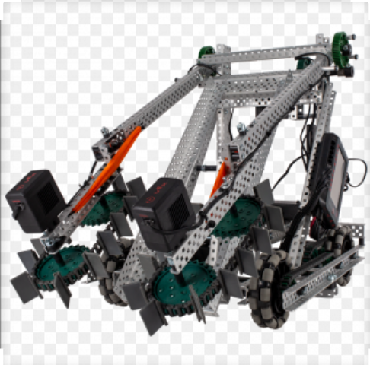
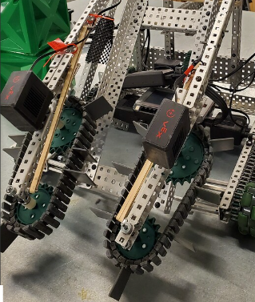
Intake Research
Research Page:
Identify the problem:
Clearly state an individual problem that you need to try to solve, or task that you are trying to make your robot accomplish. (i.e. do you need to lift something, grab something, push something, turn better, etc.)
We need to take a block and push it into a goal.
2. Find real-world examples:
Paste in pictures, video links, or screenshots of real-world examples that look like they could do the thing you are trying to do.
3. Brainstorm:
How could this example be scaled down or changed to solve your problem? What could you do to make it work?
We could use the rubber parts to scoop the blocks up.
Tyler
08/26/25
6

Slide 31
“High Stakes” Starting Field with Frozen Game Objects
Start
Dontae
08/29/25
7

Slide 32
Sprint Retrospective
Sprint #:
Team:
Team Members Present:
1
Dontae Brown
Tyler Painter
Alice Schutt
TyDoMaL
During the Sprint Retrospective you will talk with your team and discuss the last sprint. You will need to reflect on how well your team is working together, be respectful but honest, and everyone should be allowed to express themselves. Then, answer the following questions:
What is working for our team, that we should CONTINUE doing (use complete sentences):
We should continue researching and planning the design for our robot, working well as a team, and getting the work we need to done
2. What is not working for our team, that we should STOP doing (use complete sentences):
We should stop getting off task. We should stop rushing ahead and figure out what each thing we will do before we start building. We could improve communication on where were at with the process.
3. What do we want to try doing as a team, that we should START doing (use complete sentences):
For Each thing we want to stop doing, we should have a thing to start that solves the issue!
We can stay on task better by focusing on our respective roles, by keeping each other accountable. We should try to figure out if something works before wasting time building it, by making small prototypes to test ideas.
08/29/2025
8
Date:
Page:

Slide 33
Sprint Review
Sprint #:
Team:
1
Team Members Present:
TyDoMaL
Alice Schutt
Dontae Brown
Tyler Painter
Using complete sentences, give a summary of what your team accomplished this sprint. Also, identify which product backlog items you fully completed:
During this sprint we have completed the researching and building of the drivetrain. We have also created a plan for the skills, began testing the drivetrain, and did a little coding of the drivetrain.
2. Using complete sentences, tell me what your sprint goal was, did you meet that goal this sprint, and why you did or did not meet that goal:
Our sprint goal was to make the base of a robot, the drivetrain, and to test and evaluate it. Also, to code and build the controller code. We did meet this goal because we made the base, the drivetrain, did some testing, some coding, and built a basic controller code.
3. What sprint backlog items do you need to move back to your product backlog? Put them in order of priority, highest priority should be at the top of the list.
No specific backlog items, but we want to focus on more testing and build on the controller code more. We also might need to add more sensors in the future.
4. Demonstrate the product that you produced this sprint.
Page:
9

Slide 34
Sprint Plan (Sprint backlog and burndown)
Sprint #:
Team:
2
Team Members Present:
TyDoMal
Dontae Brown
Marco Banuelos
Alice Schutt
Product Backlog (at the start of this sprint, what is your product backlog):
Create the top half of the robot
Research the top half of the robot
Create intake mechanism
Create outtake mechanism
Coding​
Testing
Sprint Goal (write in full sentences what concise goal you have for the sprint):
Our sprint goal is to get a strafe code done and to build and test the intake mechanism also maybe start the autonomous as well as maybe start the output.
Sprint Backlog / Burndown (Break product backlog items into sprint backlog items)
Remember to INDENT sprint backlog items:
Task D Date and name of who worked on:
Intake Mechanism
Research intake | Tyler 9/4/2025
Build | Marco 9/6-18/2025
Test | Marco 9/19/2025
Coding | Dontae Brown
C++ Tutorial | Dontae 9/5-12/2025
Code motors for strafe | Dontae 9/12-
Strategize for autonomous | Dontae 9/
Autonomous begin
Test codes
Output Mechanism
Research output mechanisms | Marco 9/4/2025
Build
Test
10
Page:

Slide 35
Scrum meeting. Week of: MM/DD/YYYY
SCRUM Meetings
Week of 09/03-06/2025
Monday: What has each team member done since the last meeting? absent What will each team member do today? What problems are holding the team back?
Tuesday: What has each team member done since the last meeting? absent What will each team member do today? What problems are holding the team back?
Wednesday: What has each team member done since the last meeting? What will each team member do today? Class Talk What problems are holding the team back?
Thursday: What has each team member done since the last meeting? Not much What will each team member do today? Dontae will start trying to code strafe. Alice will organize the notebook and do research like Marco. What problems are holding the team back? None
Friday: What has each team member done since the last meeting? Dontae started coding, Marco started researching, and Alice organized the notebook. What will each team member do today? Dontae will continue coding, Marco will continue researching, and Alice will research What problems are holding the team back? None
Marco
11

Slide 36
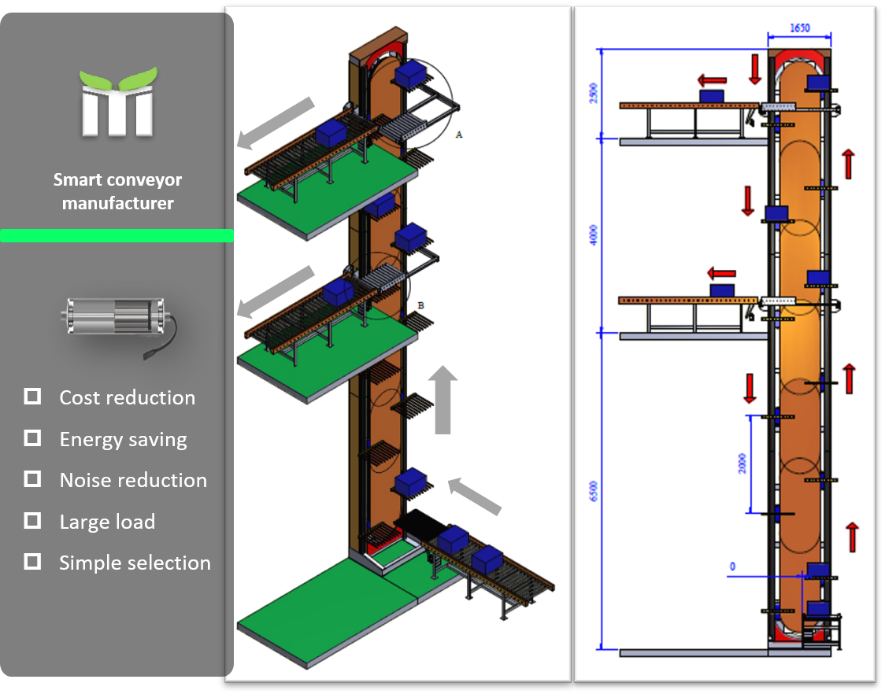
Research page
Research Page:
Identify the problem:
Clearly state an individual problem that you need to try to solve, or task that you are trying to make your robot accomplish. (i.e. do you need to lift something, grab something, push something, turn better, etc.)
We need to be able to pick up blocks and drop them off at different levels
2. Find real-world examples:
Paste in pictures, video links, or screenshots of real-world examples that look like they could do the thing you are trying to do.
3. Brainstorm:
How could this example be scaled down or changed to solve your problem? What could you do to make it work?
We are thinking of making an elevator type conveyer to lift balls up and score at different levels
Marco
08/10/25
12

Slide 37




Outake Output
Plan and Design Page:
-Drag, drop, rotate, and position vex V5 parts from the PowerPoint “V5 Parts Library” onto this slide to plan out how your robot or robot mechanism will fit together.
-Use the ‘crop’ tool to cut pieces down, DO NOT just drag them bigger/smaller. This will mess up the scale of your design, and the parts will not fit together on your robot that way.
-This design should come AFTER a filled-out research page.
-This design isn’t a copy of what we already built, it’s a plan for what we want to build.
Marco
09/08/2025
13

Slide 38
Scrum meeting. Week of: MM/DD/YYYY
SCRUM Meetings
Week of 09/8-12/2025
Monday: What has each team member done since the last meeting? TP Was sick, DB attempt to do drivetrain, MB AS brainstorm the output system. What will each team member do today? DB will study C++, MB and TP will fill out research page and brainstorm designs for the output AS is absent What problems are holding the team back? Multiple absences
Tuesday: What has each team member done since the last meeting? Designing robot output, and DM was learning C++ What will each team member do today? MB TP will finish the design page and DM will study C++ What problems are holding the team back? Half scale pieces not being half scaled
Wednesday: What has each team member done since the last meeting? DB has finished learning C++, MB AL TP created robot designs What will each team member do today? TP AL MB will start building the input and output for the robot, DB will start the drivetrain code What problems are holding the team back? We don’t have an intake and output
Thursday: What has each team member done since the last meeting? TP and DB tried to figure drivetrain out, AS MB continued to figure out the output and intake What will each team member do today? TP and DB will continue code and MB AS will start adding to the robot What problems are holding the team back? The code was not saved
Friday: What has each team member done since the last meeting? DM and TP partialy created code, MB AL planned input What will each team member do today? DM TP continue code and AS MB will start creating input What problems are holding the team back? The input and output
Tyler
14

Slide 39



Draft intake
Plan and Design Page:
-Drag, drop, rotate, and position vex V5 parts from the PowerPoint “V5 Parts Library” onto this slide to plan out how your robot or robot mechanism will fit together.
-Use the ‘crop’ tool to cut pieces down, DO NOT just drag them bigger/smaller. This will mess up the scale of your design, and the parts will not fit together on your robot that way.
-This design should come AFTER a filled-out research page.
-This design isn’t a copy of what we already built, it’s a plan for what we want to build.
Alice
08/10/25
15

Slide 40
Scrum meeting. Week of: 09/15-20/2025
SCRUM Meetings
Week of 09/15-20/2025
Monday: What has each team member done since the last meeting? MB AL created intake and TP DB continued drivetrain What will each team member do today? TP MB Continue on intake AL DB are absent What problems are holding the team back? We need to make the intake
Tuesday: What has each team member done since the last meeting? We have created the intake. What will each team member do today? Edit the book and create the ramp. What problems are holding the team back? We don’t have a ramp for the intake.
Wednesday: What has each team member done since the last meeting? We stablized the intake. What will each team member do today? We will make the motors spin faster. What problems are holding the team back? Motors are not spinning fast.
Thursday: What has each team member done since the last meeting? We fixed the intake DB is not here What will each team member do today? We will try to figure out DB code What problems are holding the team back? DB is not here
Friday: What has each team member done since the last meeting? Fixed the intake What will each team member do today? DB TP will work on code, MB AL work on upper half of robot. What problems are holding the team back? We have to rewrite code
Tyler
16

Slide 41
Scrum meeting. Week of: 09/22/2025
SCRUM Meetings
Week of 09/22-27/2025
Monday: What has each team member done since the last meeting? MB and AL put on two pillars What will each team member do today? TP, DB will continue on code as well as AL and MB continue on top of robot What problems are holding the team back? The Code has a lot of errors
Tuesday: What has each team member done since the last meeting? Continued on code and top of robot What will each team member do today? Sprint Review and Retrospective as well as the What problems are holding the team back? Need to do sprint review and retrospective
Wednesday: What has each team member done since the last meeting? Sprint Review, Retrospective, Plan What will each team member do today? DB will do Atounomus code MB and AL will work on outtake What problems are holding the team back? DB confused on code
Thursday: What has each team member done since the last meeting? Worked on code and outtake What will each team member do today? TP will check notebook DB will code and MB AL will build outtake What problems are holding the team back? No outtake
Friday: What has each team member done since the last meeting? Worked on outtake and code What will each team member do today? DB and TP will code AS and MB will work on outtake What problems are holding the team back? No outtake and
Tyler
17

Slide 42
Sprint Retrospective
Sprint #:
Team:
Team Members Present:
2
Dontae Brown
Tyler Painter
Alice Schutt
Marco Banuelos
TyDoMaL
During the Sprint Retrospective you will talk with your team and discuss the last sprint. You will need to reflect on how well your team is working together, be respectful but honest, and everyone should be allowed to express themselves. Then, answer the following questions:
What is working for our team, that we should CONTINUE doing (use complete sentences):
The ability to divide and conquer tasks and planning on things before we decide to start them.
2. What is not working for our team, that we should STOP doing (use complete sentences):
Our amazing ability to get off topic and get in ridiculous conversations.
3. What do we want to try doing as a team, that we should START doing (use complete sentences):
For Each thing we want to stop doing, we should have a thing to start that solves the issue!
We want to start focusing more on the task at hand. We will do this by whenever we start getting of task and we realize it we will help each other refocus. Whoever is off topic will look at the sprint plan and explain were we are at.
08/29/2025
18
Date:
Page:

Slide 43
Sprint Review
Sprint #:
Team:
2
Team Members Present:
TyDoMaL
Alice Schutt
Dontae Brown
Tyler Painter
Marco Banuelos
Using complete sentences, give a summary of what your team accomplished this sprint. Also, identify which product backlog items you fully completed:
During this sprint we have completed all the initial research, building the intake, testing the intake, and coding tutorials. We have finished researching the top of the robot but have not otherwise finished any product backlog items.
2. Using complete sentences, tell me what your sprint goal was, did you meet that goal this sprint, and why you did or did not meet that goal:
Our sprint goal was to get a strafe code done, build and test the intake mechanism, maybe start the autonomous, and maybe start the output. We did not complete this sprint goal because the strafe code is not complete, and we did not start the autonomous. However, we did complete the intake mechanism and started the output.
3. What sprint backlog items do you need to move back to your product backlog? Put them in order of priority, highest priority should be at the top of the list.
At the top we need to still complete the coding, the output. Coding gets priority as it is behind compared to the building.
4. Demonstrate the product that you produced this sprint.
Page:
19

Slide 44
Sprint Plan (Sprint backlog and burndown)
Sprint #:
Team:
3
Team Members Present:
TyDoMal
Dontae Brown
Marco Banuelos
Alice Schutt
Tyler Painter
Product Backlog (at the start of this sprint, what is your product backlog):
Create the top half of the robot
Create outtake mechanism
Test outtake mechanism
Coding​
Attounomus and drivetrain
Test the coding
Sprint Goal (write in full sentences what concise goal you have for the sprint):
Our sprint goal is to get a strafe code done and to build and test the outake mechanism also maybe start the autonomous.
Sprint Backlog / Burndown (Break product backlog items into sprint backlog items)
Remember to INDENT sprint backlog items:
Task D Date and name of who worked on:
Coding | Dontae Brown
Code motors for strafe | Dontae 9/12-
Strategize for autonomous | Dontae 9/
Autonomous begin
Test codes
Output Mechanism
Build | Marco Brown and Alice Schutt finish 9/9/25
Test | Alice 10/20/25
20
Page:

Slide 45
Testing Worksheet
Mechanism: Builder:
Tester:
Alice and Marco
Tyler
Use this worksheet to test the mechanism that you researched, planned, and then built.
Does the mechanism perform the function as intended?
Does the mechanism fit within the games rule requirements?
Durability testing, does the mechanism hold up to the following?
Impact - (bump from various directions)
Torsion - (twisting force, try and spin it.)
Load - (does it hold appropriate weight)
Torque - (if is motorized, can it supply enough power?)
Bending - (apply force to one side, then another)
Handling - (Does the robot still drive as expected with the mechanism installed?)
Cycle - (how many times can it do its function repeatedly)
Does the mechanism perform under game conditions?
Test Feedback:
What did you learn from your testing? Think about usable quantitative data (measurements) and qualitative data (observations and opinions). Do we need a full redesign, or can we change something small to gain the functionality that we wanted? If redesign is needed, go back to the research/brainstorm step, and do that worksheet again!
09/23/2025
21
Date:
Page:

Slide 46
Scrum meeting. Week of: MM/DD/YYYY
SCRUM Meetings
Week of 09-10/29-03/2025
Monday: What has each team member done since the last meeting? DB worked on code and MB and AS worked on outtake What will each team member do today? DB will code and AS and MB will work on outtake What problems are holding the team back? No outtake and code
Tuesday: What has each team member done since the last meeting? Worked on code and outtake What will each team member do today? DB work on code MB and AS work on outtake What problems are holding the team back? No diver code and outtake
Wednesday: What has each team member done since the last meeting? DB worked on code and AL and worked on outtake What will each team member do today? DB work on code and MB AL and TP will work on the outtake What problems are holding the team back? No code and outtake
Thursday: What has each team member done since the last meeting? AL MB TP worked on conveyor DB worked on coding What will each team member do today? TP AL MB fix conveyor and DB code What problems are holding the team back? No ottake and code
Friday: What has each team member done since the last meeting? Fixing conveyor and DB code What will each team member do today? TP AL MB fix conveyor belt, and DB fix code What problems are holding the team back? Convetor belt and code
Tyler
22

Slide 47
Scrum meeting. Week of: MM/DD/YYYY
SCRUM Meetings
Week of 10/06/2025
Monday: What has each team member done since the last meeting? MB TP and AS fixed conveyor belt What will each team member do today? AL and TP continue on outtake and DB continue on code What problems are holding the team back? No code and outtake
Tuesday: What has each team member done since the last meeting? Tested autonomous code What will each team member do today? TP DB AS Secure intake and work on outtake MB is absent What problems are holding the team back? Not secure intake
Wednesday: What has each team member done since the last meeting? Work on the top of robot What will each team member do today? TP will work on re-designing brain and MB DB AS work on brain and securing intake What problems are holding the team back? Intake not secure
Thursday: What has each team member done since the last meeting? We worked on the top robot What will each team member do today? AS MB will work on top of robot, TP will work on design What problems are holding the team back? No outtake and code is not done
Friday: What has each team member done since the last meeting? We were gone :) What will each team member do today? What problems are holding the team back?
Tyler
23

Slide 48



Frame and wheels as well as brain and battery
Plan and Design Page:
-Drag, drop, rotate, and position vex V5 parts from the PowerPoint “V5 Parts Library” onto this slide to plan out how your robot or robot mechanism will fit together.
-Use the ‘crop’ tool to cut pieces down, DO NOT just drag them bigger/smaller. This will mess up the scale of your design, and the parts will not fit together on your robot that way.
-This design should come AFTER a filled-out research page.
-This design isn’t a copy of what we already built, it’s a plan for what we want to build.
Marco and Tyler
8/19-21/2025
24

Slide 49
Scrum meeting. Week of: MM/DD/YYYY
SCRUM Meetings
Week of 10/20/2025
Monday: What has each team member done since the last meeting? Created outtake and code What will each team member do today? Connect controller and test maybe What problems are holding the team back? We cant connect controller to robot
Tuesday: What has each team member done since the last meeting? We connected the controller What will each team member do today? MB AS and TP will work on the robot and DB will fix code What problems are holding the team back? The convetor cannot lift the balls into the outtake
Wednesday: What has each team member done since the last meeting? The sprint review and retrospective What will each team member do today? Connect controller and test What problems are holding the team back? We have not tested and controller is not connect
Thursday: What has each team member done since the last meeting? Fixed code and connected controller What will each team member do today? MB TP and AS will work on robot and DB will work on autonomus code What problems are holding the team back? Robot is to high
Friday: What has each team member done since the last meeting? We fixed the robot What will each team member do today? DB will code and TP MB and AS will continue fixing robot What problems are holding the team back? The Robot is too tall
Tyler
25

Slide 50
Sprint Retrospective
Sprint #:
Team:
Team Members Present:
3
Dontae Brown
Tyler Painter
Alice Schutt
Marco Banuelos
TyDoMaL
During the Sprint Retrospective you will talk with your team and discuss the last sprint. You will need to reflect on how well your team is working together, be respectful but honest, and everyone should be allowed to express themselves. Then, answer the following questions:
What is working for our team, that we should CONTINUE doing (use complete sentences):
We should continue to divide in our work.
2. What is not working for our team, that we should STOP doing (use complete sentences):
Our amazing ability to get off topic and get in ridiculous conversations. We should fill out our sprint plan as well.
3. What do we want to try doing as a team, that we should START doing (use complete sentences):
For Each thing we want to stop doing, we should have a thing to start that solves the issue!
We want to start focusing more on the task at hand. We will do this by whenever we start getting of task and we realize it we will help each other refocus. Whoever is off topic will look at the sprint plan and explain where we are at, and they should update it as well.
10/31/2025
26
Date:
Page:

Slide 51
Sprint Review
Sprint #:
Team:
3
Team Members Present:
TyDoMaL
Alice Schutt
Dontae Brown
Tyler Painter
Marco Banuelos
Using complete sentences, give a summary of what your team accomplished this sprint. Also, identify which product backlog items you fully completed:
During this sprint we completed building the outtake and did an initial test completing the product backlog item of creating the top half of the robot. We also moved the brain and battery to more secure and accessible locations.
2. Using complete sentences, tell me what your sprint goal was, did you meet that goal this sprint, and why you did or did not meet that goal:
Our sprint goal was to get a strafe code done, to build and test the outtake mechanism and maybe start the autonomous. During this sprint we did not meet the sprint goal because the autonomous was not started. We did, however, build and test the outtake as well as completed the strafe code.
3. What sprint backlog items do you need to move back to your product backlog? Put them in order of priority, highest priority should be at the top of the list.
We need to move back coding the autonomous as the highest priority.
4. Demonstrate the product that you produced this sprint.
Page:
27

Slide 52
Competition reflection
Bring license plates
Get to matches on time
Make time for skills
Upload code in right spot
Test when possible
Organize matches
Organize interview
Be on time
Communication between team
Be ready for inspection
Communicate more with alliance partners
Ask questions
Intake that can bring balls in from loader
Outtake that can allow for better scoring
Fix the ramp at end and start of conveyor
Tyler Dontae, Marco, and Alice
30

Slide 53
Scrum meeting. Week of: MM/DD/YYYY
SCRUM Meetings
Week of 11/03/2025
Monday: What has each team member done since the last meeting? What will each team member do today? What problems are holding the team back?
Tuesday: What has each team member done since the last meeting? We did a competition reflection What will each team member do today? Sprint plan What problems are holding the team back? Dontea not being here
Wednesday: What has each team member done since the last meeting? We did the sprint plan What will each team member do today? AS, and DB are coding and TP will drive What problems are holding the team back? We don’t have autonomous code
Thursday: What has each team member done since the last meeting? TP driven the robot What will each team member do today? Fix intake DB will plan What problems are holding the team back? Intake cannot take balls out of loader
Friday: What has each team member done since the last meeting? What will each team member do today? What problems are holding the team back?
31

Slide 54
Sprint Plan (Sprint backlog and burndown)
Sprint #:
Team:
4
Team Members Present:
TyDoMaL
Tyler, Alice, Marco, Dontea
Product Backlog (at the start of this sprint, what is your product backlog):
Coding
Autonomous
Skills Autonomous
Build
Work on consistency of output and intake
Sprint Goal (write in full sentences what concise goal you have for the sprint):
We would like to finish the coding and fix the intake and output.
Sprint Backlog / Burndown (Break product backlog items into sprint backlog items)
Remember to INDENT sprint backlog items:
Task Date and name of who worked on:
Coding
Match Autonomous
Skills Autonomous
Build
Output | 11/12/2025
Intake
32
Page:

Slide 55
Scrum meeting. Week of: MM/DD/YYYY
SCRUM Meetings
Week of 11/10/2025
Monday: What has each team member done since the last meeting? DB planned What will each team member do today? DB code autonomous What problems are holding the team back? No autonomous
Tuesday: What has each team member done since the last meeting? Figured out how to fix intake What will each team member do today? We will put the big wheels on while DB codes autonomous What problems are holding the team back? The intake cannot intake loader
Wednesday: What has each team member done since the last meeting? Started attaching wheels What will each team member do today? DB CODE AL and MB attach wheels to intake What problems are holding the team back? No wheels on intake
Thursday: What has each team member done since the last meeting? Attached wheels on intake What will each team member do today? Testing and driving and fixing rub on wheels What problems are holding the team back? The straife is curving
Friday: What has each team member done since the last meeting? TP tested What will each team member do today? We will fix the strafe What problems are holding the team back? The strafe is not working
Tyler
33

Slide 56
Scrum meeting. Week of: MM/DD/YYYY
SCRUM Meetings
Week of 11/17-21/2025
Monday: What has each team member done since the last meeting? Worked on fixing the strafe What will each team member do today? AL and MB are fixing the intake while DB fixes the strafe What problems are holding the team back? Bad intake and no strafe
Tuesday: What has each team member done since the last meeting? Worked on intake What will each team member do today? TP drive robot What problems are holding the team back? Bad strafe
Wednesday: What has each team member done since the last meeting? TP drove What will each team member do today? TP will drive DB will code What problems are holding the team back? No autonomus
Thursday: What has each team member done since the last meeting? DB did code and TP drove What will each team member do today? TP and DB will test, and MB AS will fix intake What problems are holding the team back? Intake not working and no testing
Friday: What has each team member done since the last meeting? DB code AS and MB fixed the robot as TP drove What will each team member do today? TP will drive What problems are holding the team back? No code unexperianced driver
34

Slide 57
Testing Worksheet
Mechanism: Builder:
Tester:
Alice S and Marco B
Tyler Painter
Use this worksheet to test the mechanism that you researched, planned, and then built.
Does the mechanism perform the function as intended?
Does the mechanism fit within the games rule requirements?
Durability testing, does the mechanism hold up to the following?
Yup
Yup
Impact - (bump from various directions)
10
Nothing broke
Torsion - (twisting force, try and spin it.)
9
Moved a little
Load - (does it hold appropriate weight)
10
Yes, it does hold the appropriet weight
Torque - (if is motorized, can it supply enough power?)
10
Yes, it can score with ease
Bending - (apply force to one side, then another)
8
Intake bends a little more than it should wich could hurt the motors
Handling - (Does the robot still drive as expected with the mechanism installed?)
10
Yes, it does drive as intended
Cycle - (how many times can it do its function repeatedly)
10
Works for a whole match
Does the mechanism perform under game conditions?
Yup
Test Feedback:
What did you learn from your testing? Think about usable quantitative data (measurements) and qualitative data (observations and opinions). Do we need a full redesign, or can we change something small to gain the functionality that we wanted? If redesign is needed, go back to the research/brainstorm step, and do that worksheet again!
The only thing is that the intake motors are in danger if force is applied to the intake front.
11-20-2025
35
Date:
Page:

Slide 58
Scrum meeting. Week of: MM/DD/YYYY
SCRUM Meetings
Week of 12/1-5/2025
Monday: What has each team member done since the last meeting? TP DROVE What will each team member do today? DB will code TP will drive What problems are holding the team back? No code
Tuesday: What has each team member done since the last meeting? TP Drove and code tested What will each team member do today? Give intake more tork and TP will drive What problems are holding the team back? No autonomus
Wednesday: What has each team member done since the last meeting? Gave intake more tork and TP drove What will each team member do today? TP will fix the notebook and drive while AL and MB work on intake What problems are holding the team back? NO AOUTONOMUS
Thursday: What has each team member done since the last meeting? AL MB worked on the intake and TP drove What will each team member do today? AL and MB will finish the intake, and TP will drive as well as DB code What problems are holding the team back? No autonomus
Friday: What has each team member done since the last meeting? What will each team member do today? What problems are holding the team back?
35

Slide 59
Convetor back
Intake Back
Convetor front
Intake front
STICK
Forward and backward
STICK
turn
BUTTON
Output front
Strafe left
BUTTON
Strafe right
BUTTON
BUTTON
Output back
36

Slide 60
Sprint Retrospective
Sprint #:
Team:
Team Members Present:
4
Dontae Brown
Tyler Painter
Alice Schutt
Marco Banuelos
TyDoMaL
During the Sprint Retrospective you will talk with your team and discuss the last sprint. You will need to reflect on how well your team is working together, be respectful but honest, and everyone should be allowed to express themselves. Then, answer the following questions:
What is working for our team, that we should CONTINUE doing (use complete sentences):
We should continue to divide in our work.
2. What is not working for our team, that we should STOP doing (use complete sentences):
Our amazing ability to get off topic and get in ridiculous conversations. We should fill out our sprint plan.
3. What do we want to try doing as a team, that we should START doing (use complete sentences):
For Each thing we want to stop doing, we should have a thing to start that solves the issue!
We want to start focusing more on the task at hand. We will do this by whenever we start getting off task and we realize it we will help each other refocus. Whoever is off topic will look at the sprint plan and explain where we are at, and they should update it as well. We should start driving in between code testing.
12/5/2025
37
Date:
Page:

Slide 61
Sprint Review
Sprint #:
Team:
4
Team Members Present:
TyDoMaL
Alice Schutt
Dontae Brown
Tyler Painter
Marco Banuelos
Using complete sentences, give a summary of what your team accomplished this sprint. Also, identify which product backlog items you fully completed:
During this sprint we modified the Intake to make it more consistent and stabilized the Outtake. We also did coding of autonomous.
2. Using complete sentences, tell me what your sprint goal was, did you meet that goal this sprint, and why you did or did not meet that goal:
Our sprint goal was to finish the coding and fix the outtake and intake. We did not meet the goal because the coding has not been finished. However, we did improve the outtake and intake and made some progress with the autonomous codes.
3. What sprint backlog items do you need to move back to your product backlog? Put them in order of priority, highest priority should be at the top of the list.
We need to move back coding the autonomous as the highest priority.
4. Demonstrate the product that you produced this sprint.
Page:
38

Slide 62
Scrum meeting. Week of: MM/DD/YYYY
SCRUM Meetings
Week of 00/08-12/2025
Monday: What has each team member done since the last meeting? TP Drove the robot DB code What will each team member do today? Fix convetor, drive and code What problems are holding the team back? No code Convetor gets stuck
Tuesday: What has each team member done since the last meeting? AL MB Fixed convetor, TP drove and DB coded What will each team member do today? AL MB will continue to fix the convetor, DB will code What problems are holding the team back? Convetor does not function as properly
Wednesday: What has each team member done since the last meeting? Fixed the convetor and Practiced skills driving What will each team member do today? Practice skills What problems are holding the team back? No autonomus
Thursday: What has each team member done since the last meeting? Practiced skills What will each team member do today? Practice sskills What problems are holding the team back? Not good skills aoutonomus
Friday: What has each team member done since the last meeting? What will each team member do today? What problems are holding the team back?
39

Slide 63
Scrum meeting. Week of: MM/DD/YYYY
SCRUM Meetings
Week of 01/7-9/2026
Monday: What has each team member done since the last meeting? What will each team member do today? What problems are holding the team back?
Tuesday: What has each team member done since the last meeting? What will each team member do today? What problems are holding the team back?
Wednesday: What has each team member done since the last meeting? Coding and testing What will each team member do today? Testing and coding What problems are holding the team back? NO autonomus works
Thursday: What has each team member done since the last meeting? Testing and coding What will each team member do today? Code and test What problems are holding the team back? No autonomus
Friday: What has each team member done since the last meeting? Code and test What will each team member do today? Code and test What problems are holding the team back? Autonomus not working
40

